Slide 1

Hi
Guys

Slide 2

INTRODUCTION
Analyze the global salary using SQL and Excel.
The dataset have 16 columns and each columns contains nulls.
Age Range, Industry, Job Title, Clarification of Job Title, Annual Salary, Additional Monetary Compensation, Currency, Other Currency, Income Clarification, Country, State, City, Years of Professional Experience Overall, Years of Professional Experience in Field, Highest Level of Education Completed, Gender

Slide 3





INTRODUCTION
Analyze the global salary using SQL and Excel.
The dataset have 16 columns and each columns contains nulls.
Age Range, Industry, Job Title, Clarification of Job Title, Annual Salary, Additional Monetary Compensation, Currency, Other Currency, Income Clarification, Country, State, City, Years of Professional Experience Overall, Years of Professional Experience in Field, Highest Level of Education Completed, Gender
ANALYSIS FLOW

Slide 4
CLEAN USING POWER
QUERY EDITOR

Slide 5
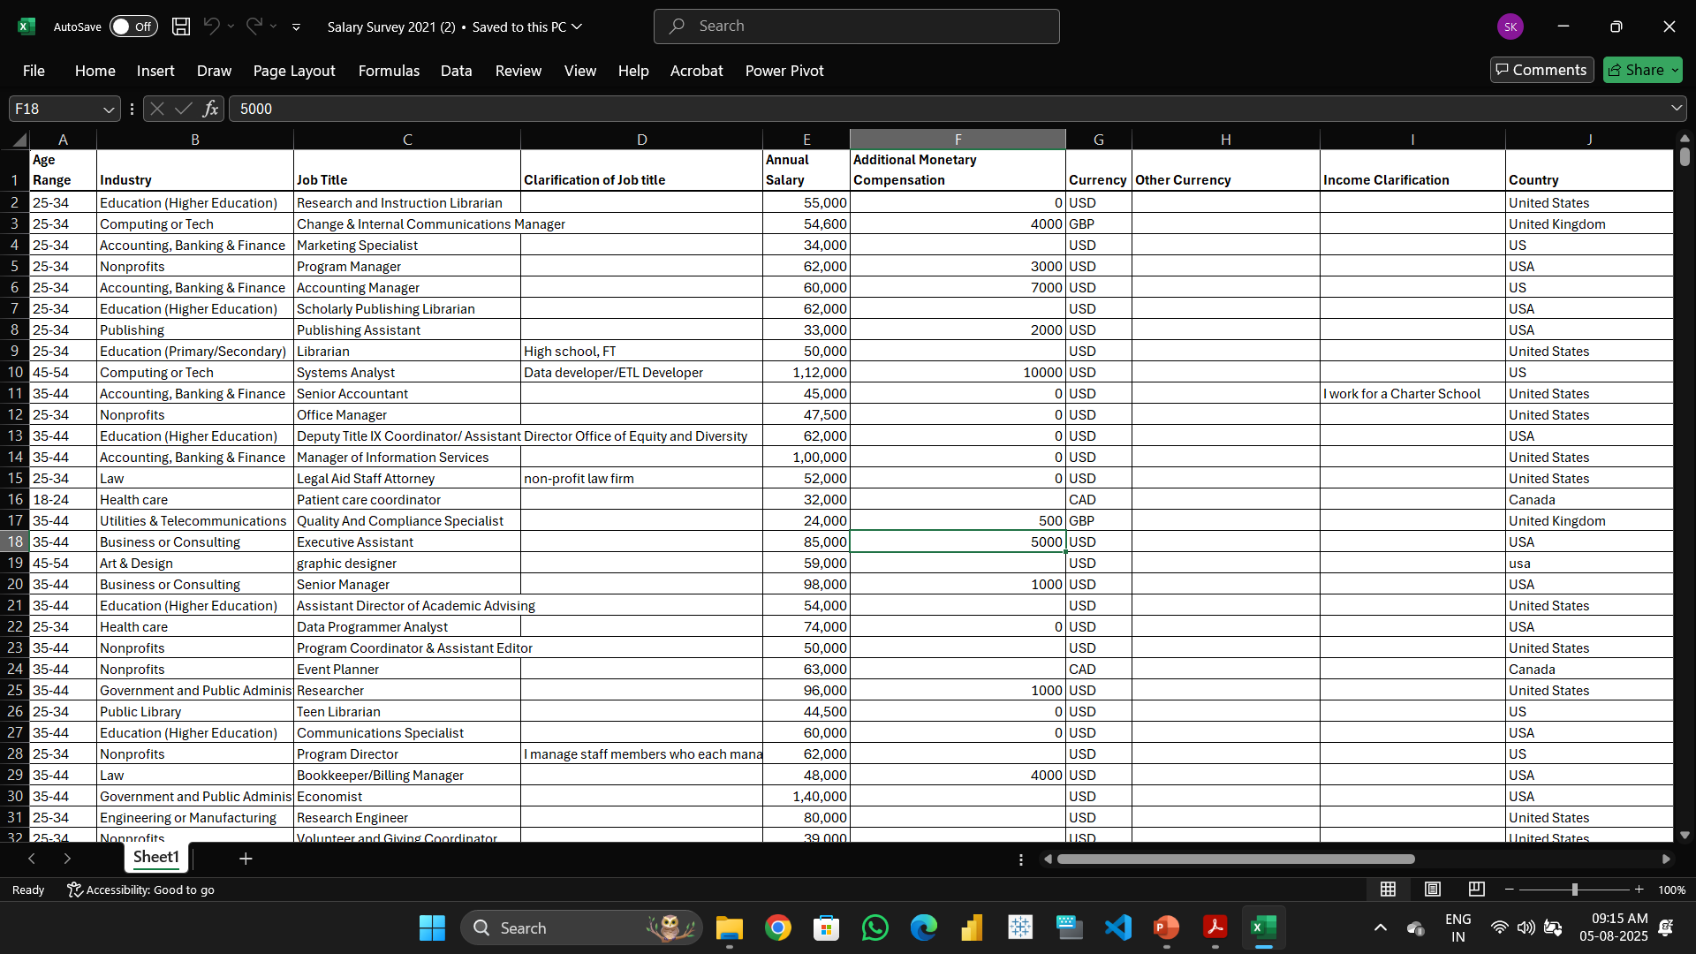
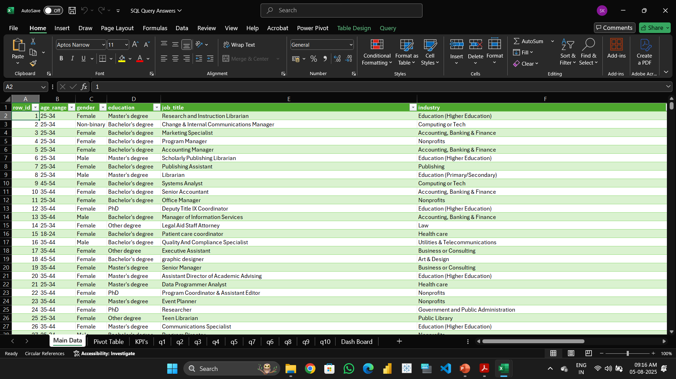
CLEAN USING POWER QUERY EDITOR

Slide 6
LOAD DATA INTO SQL

Slide 7
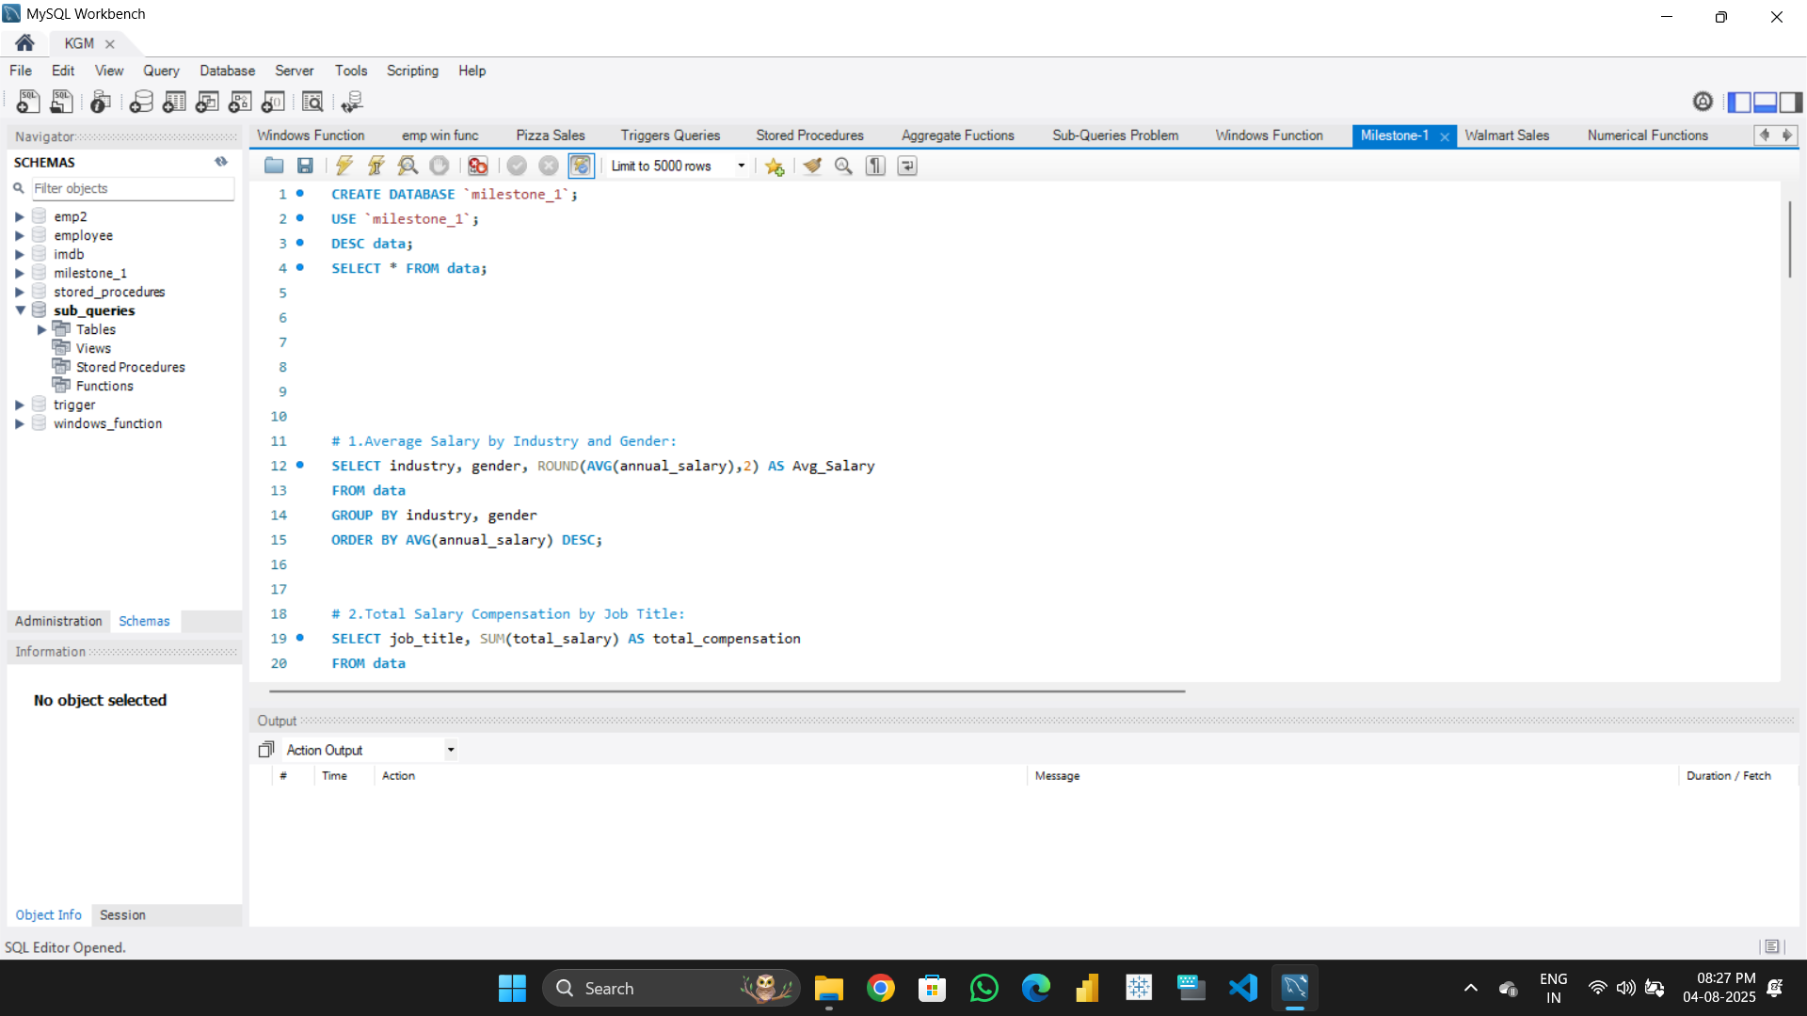
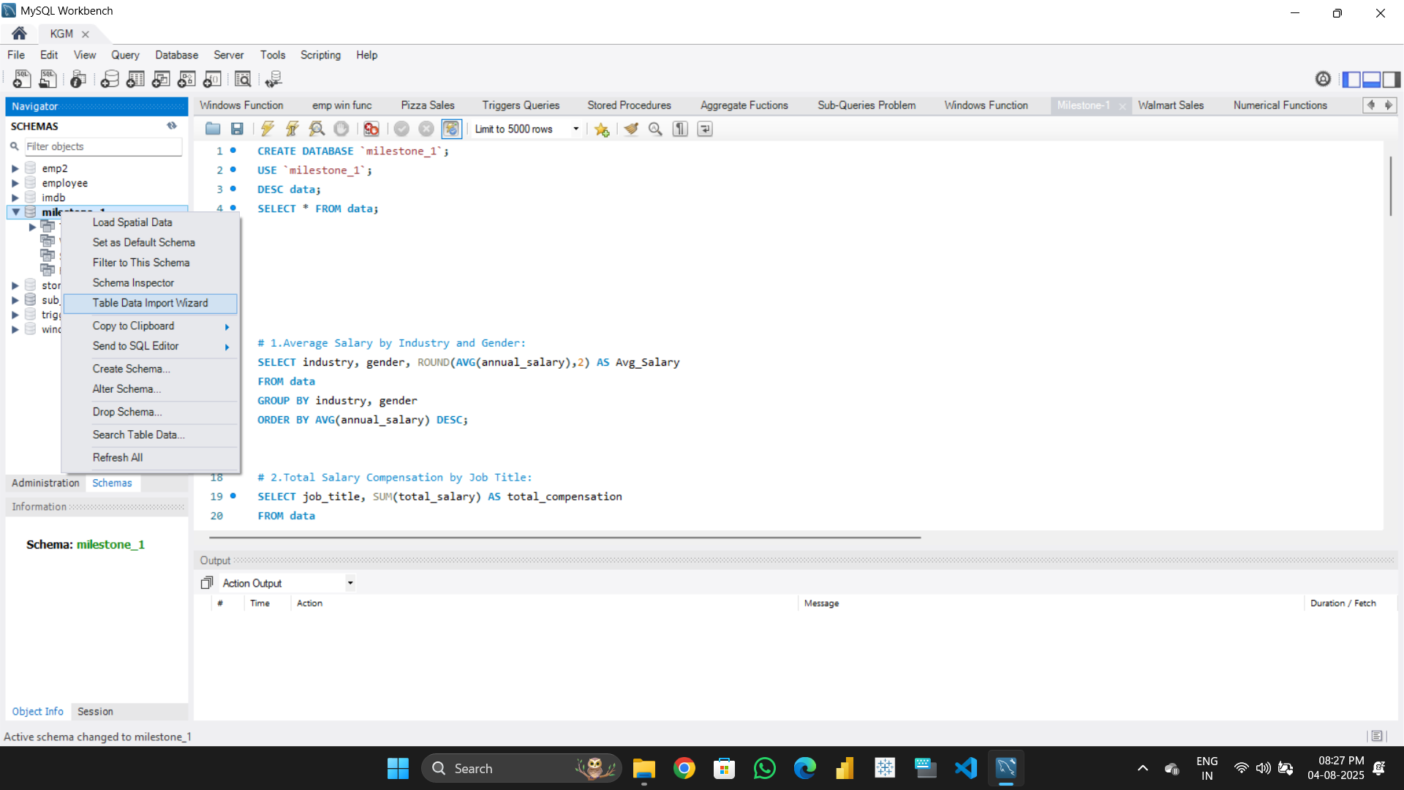
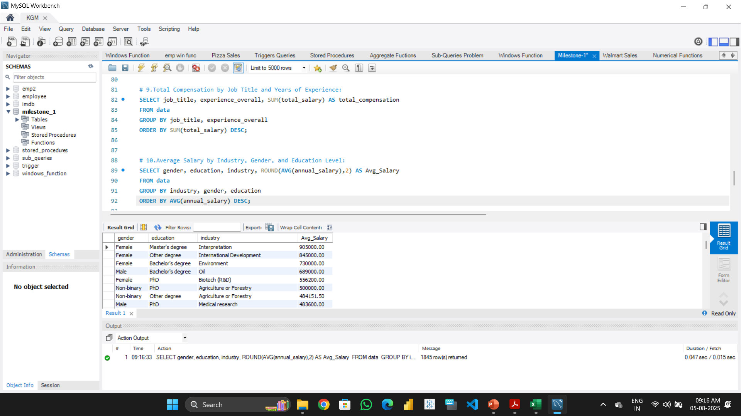
LOAD CLEANED DATA INTO MYSQL (CSV)

Slide 8
SQL QUERIES

Slide 9











SQL QUERIES
QUERY - 1

Slide 10
SQL QUERIES
QUERY - 2

Slide 11
SQL QUERIES
QUERY - 3

Slide 12
SQL QUERIES
QUERY - 4

Slide 13
SQL QUERIES
QUERY - 5

Slide 14
SQL QUERIES
QUERY - 6

Slide 15
SQL QUERIES
QUERY - 7

Slide 16
SQL QUERIES
QUERY - 8

Slide 17
SQL QUERIES
QUERY - 9

Slide 18
SQL QUERIES
QUERY - 10

Slide 19
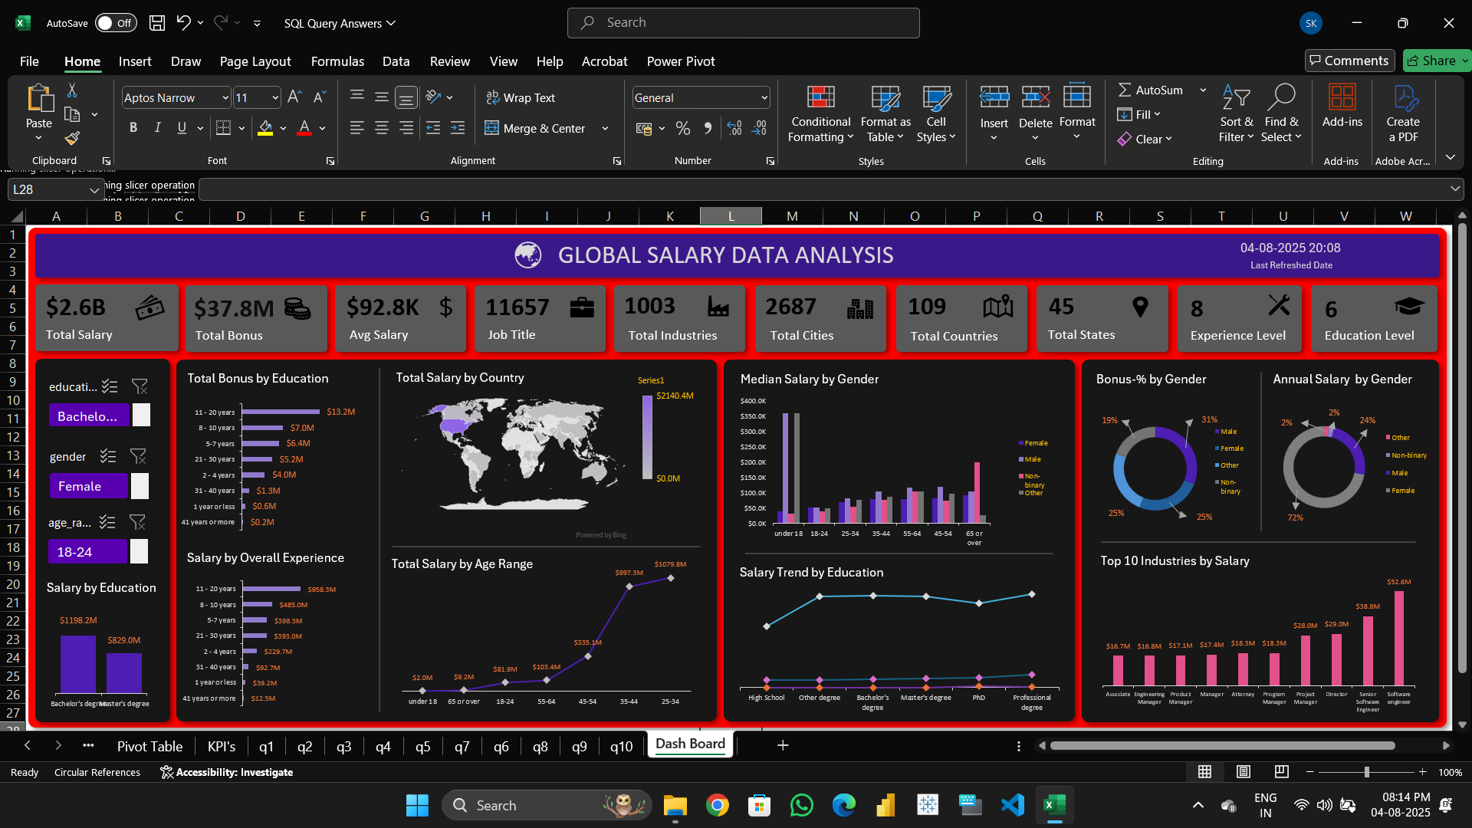
DASH BOARD

Slide 20
DASH BOARD

Slide 21
CONCLUSION
Oil, Medical Research have the highest average salary.
Software Engineer, Director have highest bonus.
Professional degree have the highest average salary.
High school have the lowest average salary.
In the data male under 18 have highest median salary
Male has highest bonus percentage

Slide 22
CONCLUSION
Oil, Medical Research have the highest average salary.
Software Engineer, Director have highest bonus.
Professional degree have the highest average salary.
High school have the lowest average salary.
In the data male under 18 have highest median salary
Male has highest bonus percentage

Slide 23
THANK YOU

Slide 25
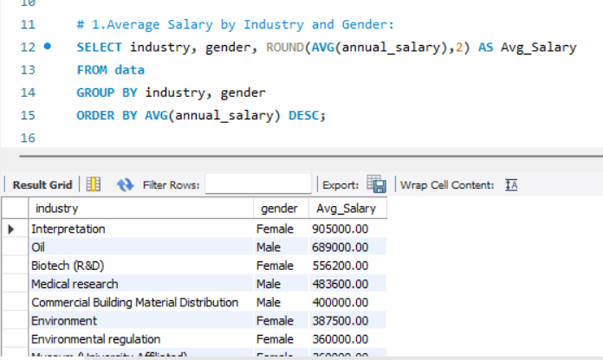
SQL QUERIES
1.Average Salary by Industry and Gender
QUERY - 1

Slide 26
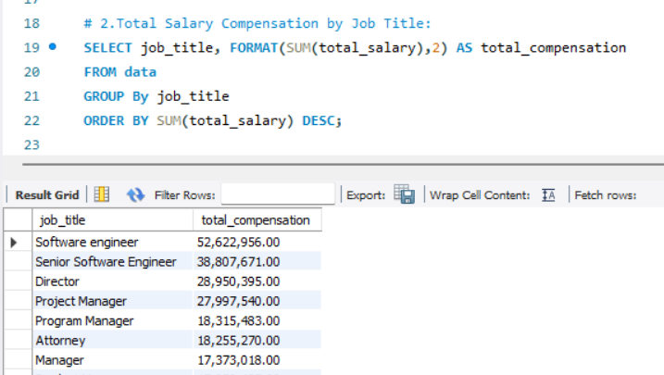
SQL QUERIES
2.Total Salary Compensation by Job Title
QUERY - 2

Slide 27
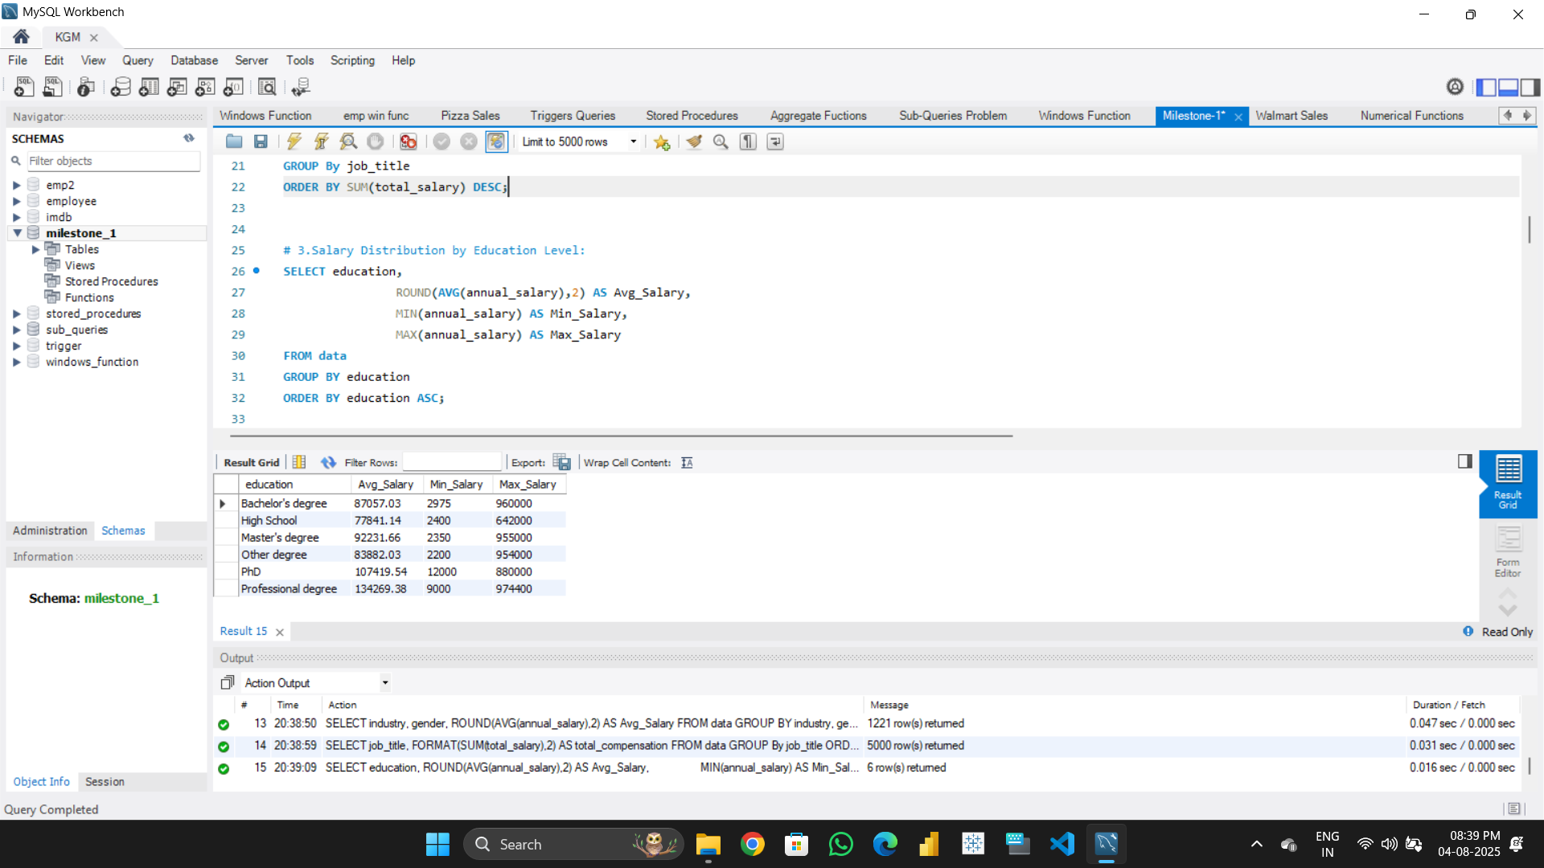
SQL QUERIES
3.Salary Distribution by Education Level
QUERY - 3

Slide 28
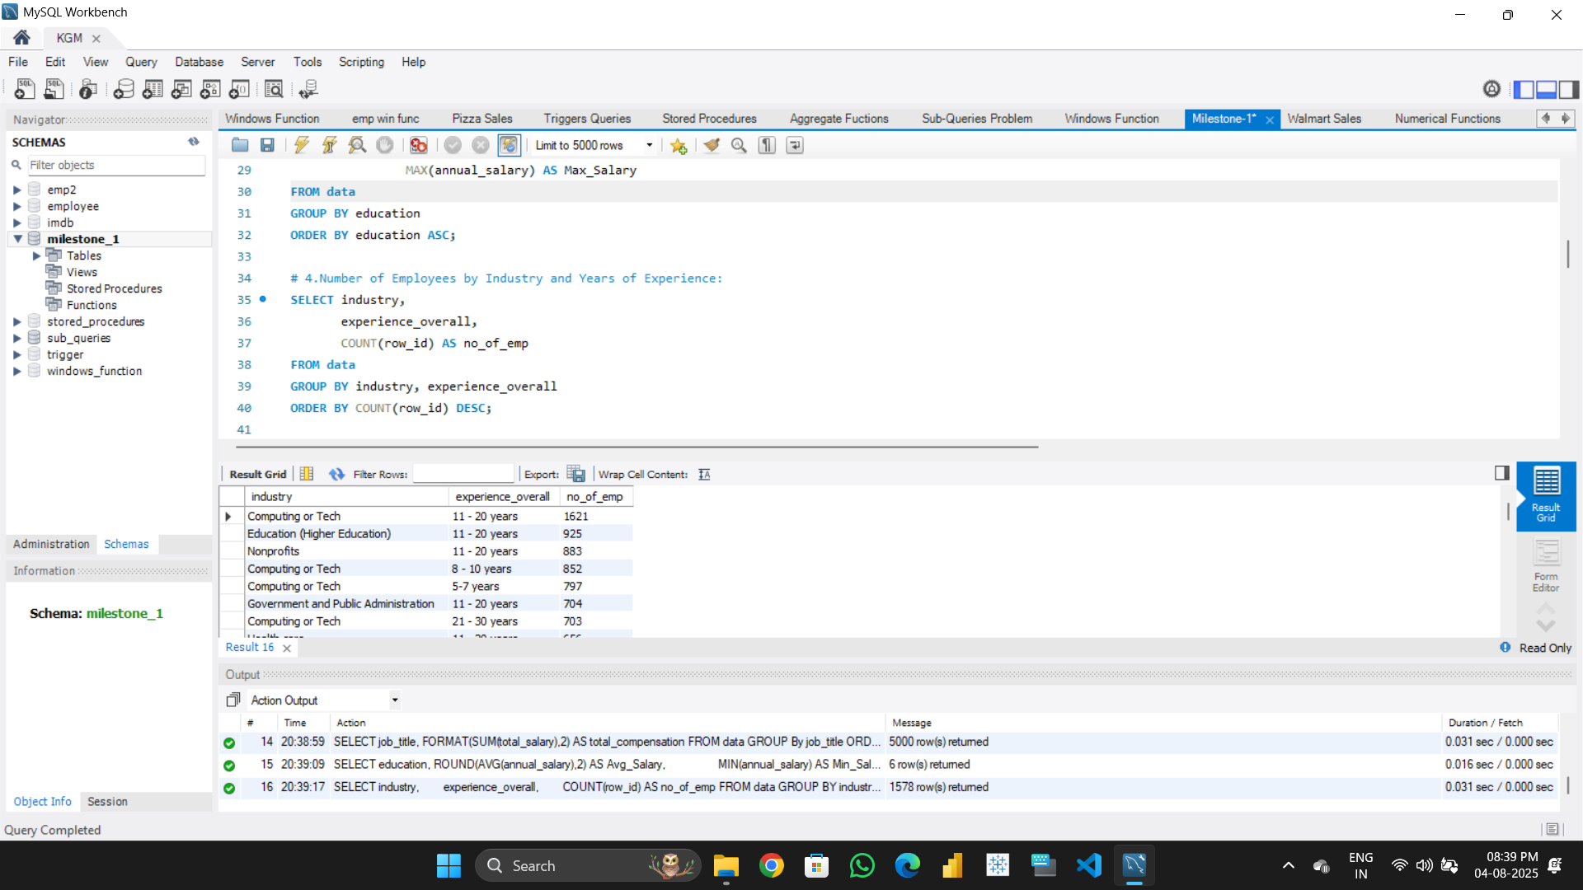
SQL QUERIES
4.No. of Emp by Industry and Years of Experience
QUERY - 4

Slide 29
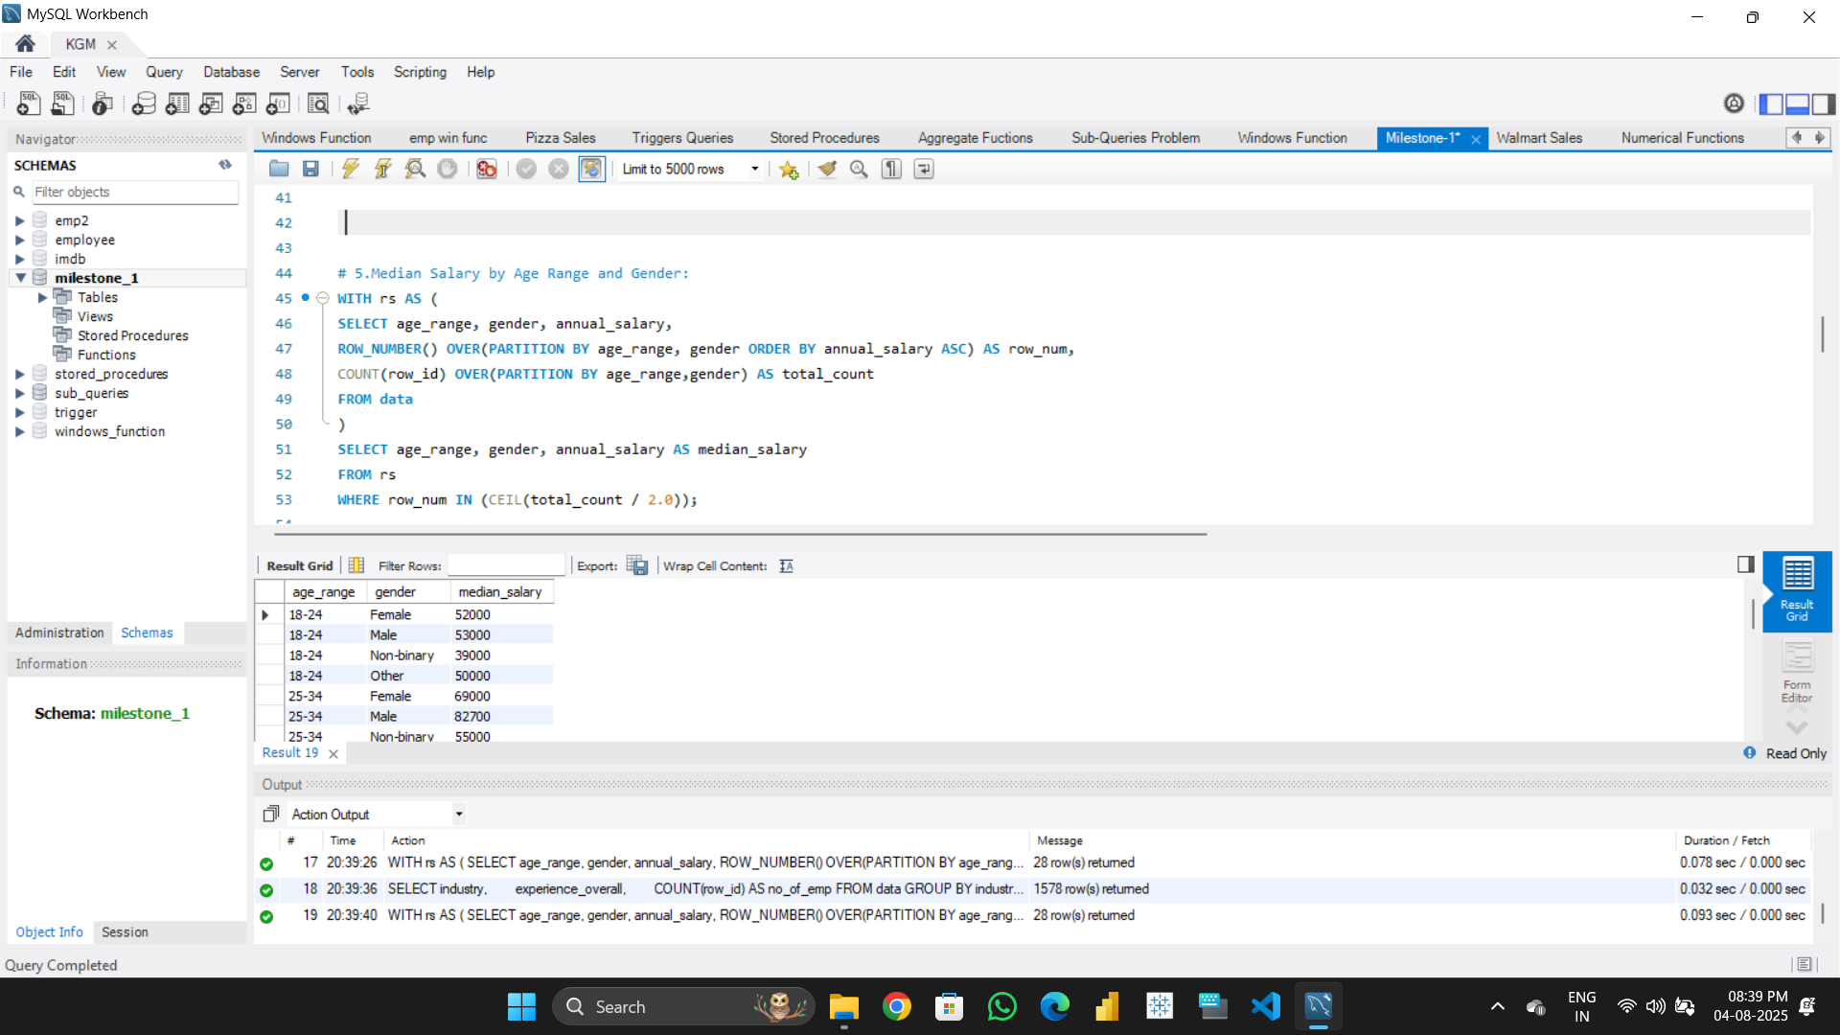
SQL QUERIES
5.Median Salary by Age Range and Gender
QUERY - 5

Slide 30
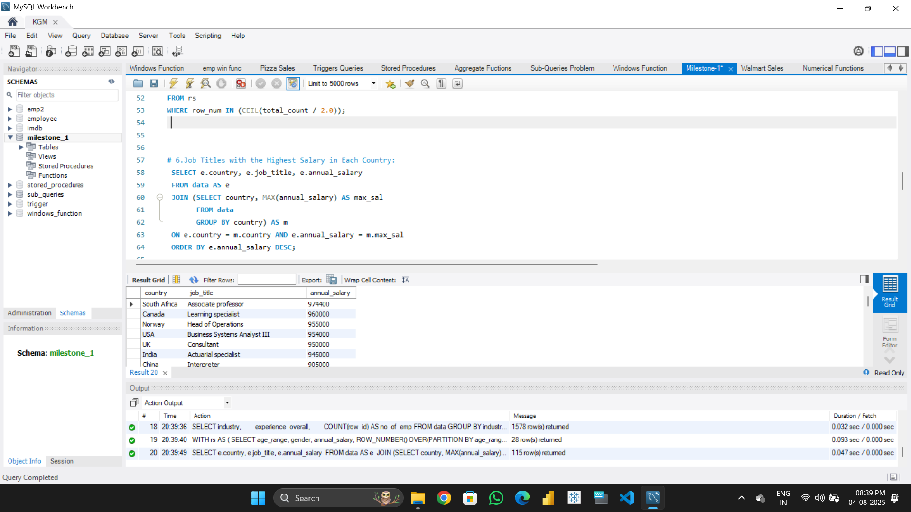
SQL QUERIES
6.Job Titles with the Highest Salary in Each Country
QUERY - 6

Slide 31
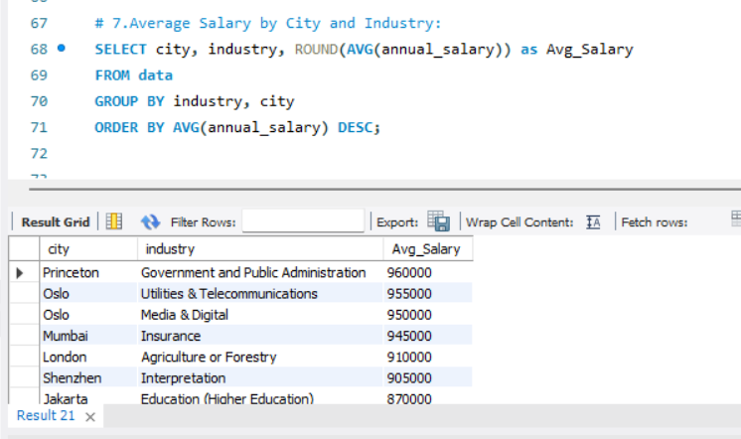
SQL QUERIES
7.Average Salary by City and Industry
QUERY - 7

Slide 32
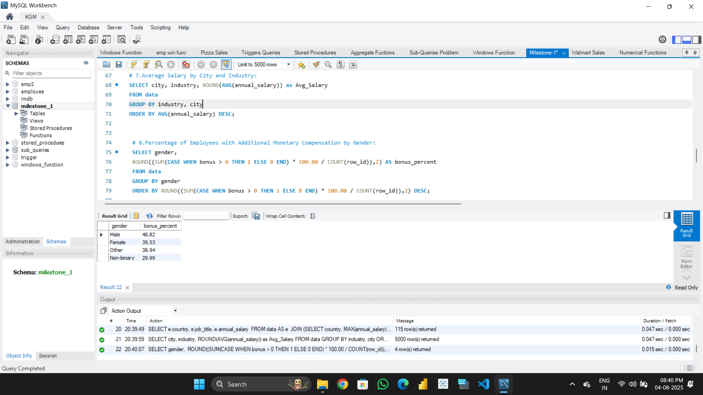
SQL QUERIES
8.Percentage of Emp with Additional Monetary Compensation by Gender.
QUERY - 8

Slide 33
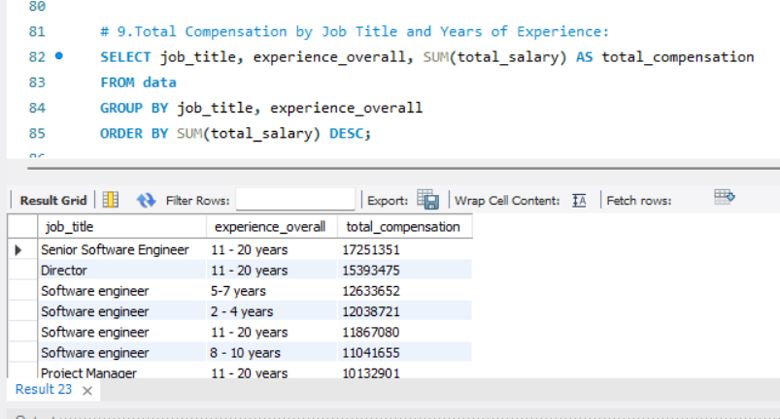
SQL QUERIES
9.Total Compensation by Job Title and Years of Experience
QUERY - 9

Slide 34
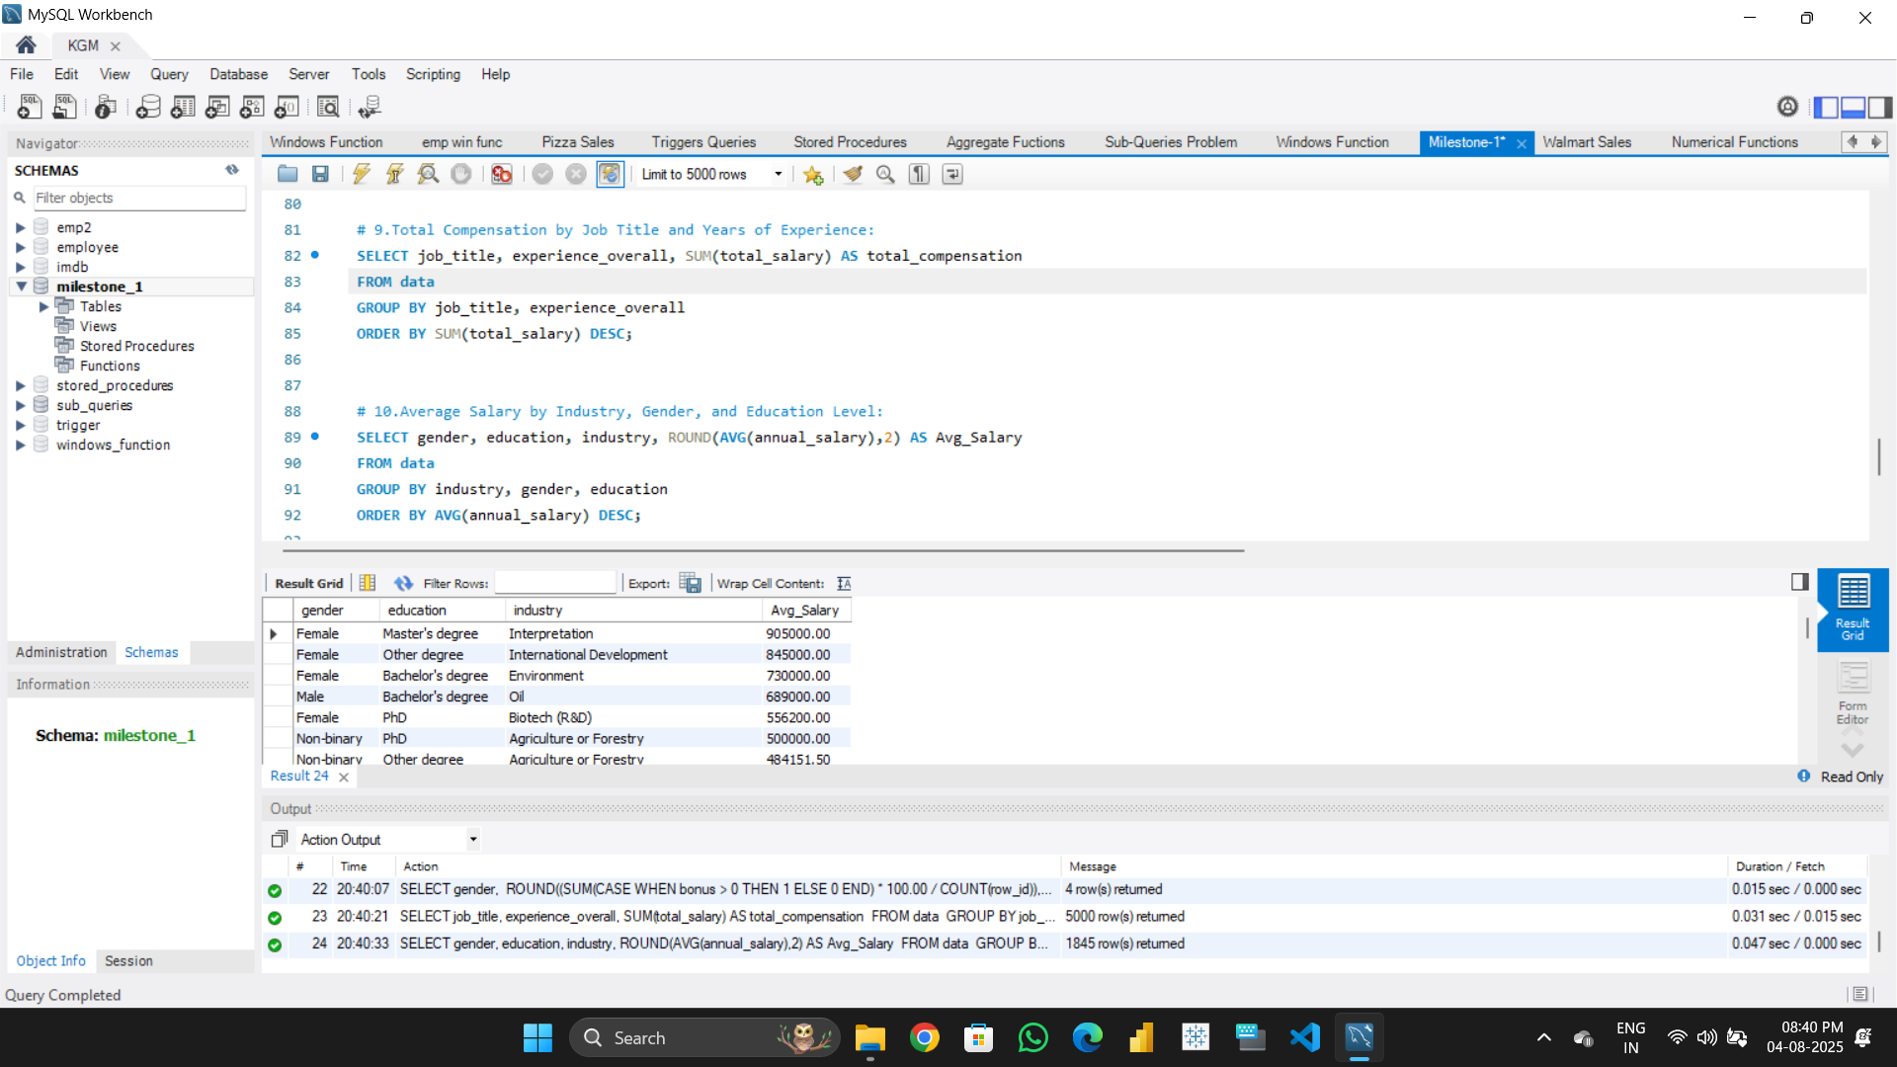
SQL QUERIES
10.Average Salary by Industry, Gender, and Education Level
QUERY - 10

